Slide 1

Predicting CLASSROOM SUCCESS FOR Jump Start ORG.
SABINA BAINS
MARCH 2022

Slide 2

BUSINESS objective
Jump Start aims to help high school students find success in the classroom for struggling NYC districts
The organization needs help allocating tutors to students who will need them most

Slide 3

Our solution
Work with school districts to distribute surveys with various questions on demographic and social attributes
Use a predictive model to determine students that are at a higher risk of failing
Allocate limited tutoring resources to these students the model has predicted to fail
Data source: https://www.kaggle.com/impapan/student-performance-data-set

Slide 4
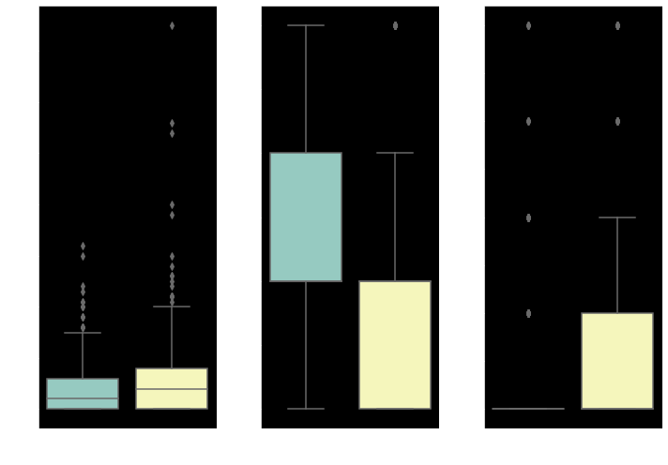
DATA and modeling
Boxplot of Student Attributes vs. Final Grade
(1= Fail, 0=Pass)
Data used for prediction consists of 1044 students from multiple high schools in Portugal
Basic student demographics
Information on parent involvement and careers
Student extracurricular activities and time spent
Values for most these attributes show significantly different means for students who pass / fail
Data source: https://www.kaggle.com/impapan/student-performance-data-set

Slide 5
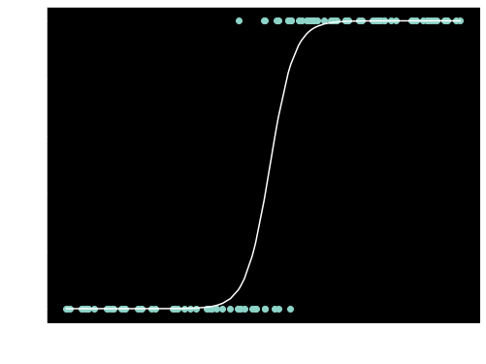
Modeling and Results
Logistic Regression Model Structure
(1= Fail, 0=Pass)
We used a classification model to predict our outcome
A model that predicts two outcomes based on existing information
For our model, this would be either passing or failing a course
Grades are recoded to a binary outcome based on whether students pass or fail their courses (students who scored under a 60% failed their course)
Our model is trained on the student’s attributes and whether they passed their course
Data source: https://www.kaggle.com/impapan/student-performance-data-set

Slide 6
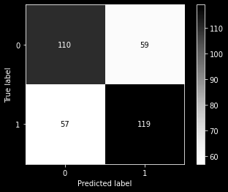
Evaluation of model
Matrix of True and Predicted Grades
(1= Fail, 0=Pass)
Overall, our model correctly predicted students who passed and those who failed 66.4% of the time.
Out of all the students who did fail, our model correctly predicted 67.6% of them
While the model is much more accurate than guessing at random chance, there is much room for improvement.
Data source: https://www.kaggle.com/impapan/student-performance-data-set

Slide 7
Effective Predictors
Certain predictors were heavily associated with an increased odds of failure
Example: Those who do not desire higher education have 1.21 times the odds of those who do desire a higher education of failing their courses.
Attribute | Increased Odds of Failure
Absences | 1.46 x
School Support = No | 1.28 x
Does Not Desire Higher Education | 1.21 x
Father has Lower Education | 1.18 x
Mother has Lower Education | 1.27x
Data source: https://www.kaggle.com/impapan/student-performance-data-set

Slide 8
Recommendations / next steps
Work with school districts to distribute surveys prior to the school year with these attributes
Run new data through model to predict which students are at risk of failing and assign tutors accordingly
Refine survey questions around most predictive attributes from Portugal dataset to increase accuracy of model

Slide 9
Thank you
Sabina Bains
Email: SabinaBains3@Gmail.com
LinkedIn:
https://www.linkedin.com/in/sabina-bains-a58645a6/

Slide 10
APPENDIX

Slide 11
Feature definitions
school - student's school (binary: 'GP' - Gabriel Pereira or 'MS' - Mousinho da Silveira)
sex - student's sex (binary: 'F' - female or 'M' - male)
age - student's age (numeric: from 15 to 22)
address - student's home address type (binary: 'U' - urban or 'R' - rural)
famsize - family size (binary: 'LE3' - less or equal to 3 or 'GT3' - greater than 3)
Pstatus - parent's cohabitation status (binary: 'T' - living together or 'A' - apart)
Medu - mother's education (numeric)
Fedu - father's education (numeric)
Mjob - mother's job (nominal: 'teacher', 'health' care related, civil 'services' (e.g. administrative or police), 'at_home' or 'other')
Fjob - father's job (nominal: 'teacher', 'health' care related, civil 'services' (e.g. administrative or police), 'at_home' or 'other')
reason - reason to choose this school (nominal: close to 'home', school 'reputation', 'course' preference or 'other')
guardian - student's guardian (nominal: ‘m
traveltime - home to school travel time (numeric: 1 - <15 min., 2 - 15 to 30 min., 3 - 30 min. to 1 hour, or 4 - >1 hour)
studytime - weekly study time (numeric: 1 - <2 hours, 2 - 2 to 5 hours, 3 - 5 to 10 hours, or 4 - >10 hours)
failures - number of past class failures (numeric: n if 1<=n<3, else 4)
other', 'father' or 'other')
schoolsup - extra educational support (binary: yes or no)
famsup - family educational support (binary: yes or no)
paid - extra paid classes within the course subject (Math or Portuguese) (binary: yes or no)
activities - extra-curricular activities (binary: yes or no)
nursery - attended nursery school (binary: yes or no)
higher - wants to take higher education (binary: yes or no)
internet - Internet access at home (binary: yes or no)
romantic - with a romantic relationship (binary: yes or no)
famrel - quality of family relationships (numeric: from 1 - very bad to 5 - excellent)
freetime - free time after school (numeric: from 1 - very low to 5 - very high)
goout - going out with friends (numeric: from 1 - very low to 5 - very high)
Dalc - workday alcohol consumption (numeric: from 1 - very low to 5 - very high)
Walc - weekend alcohol consumption (numeric: from 1 - very low to 5 - very high)
health - current health status (numeric: from 1 - very bad to 5 - very good)
absences - number of school absences (numeric: from 0 to 93)
final_grade - Pass / Fail status (1 - Fail, 0 - Pass)

